Slide 1

Project Structure and Organization

Slide 2

Goals
Notes:
Make sure we’re on the right track.
Not insulting anyone’s intelligence, just want to make sure we’re all “singing from the same sheet”

Slide 3

Agenda
Sample Project
Clean Architecture and Current Infinity Apps
Moving Away From Controllers (REPR)
Vertical Slice Architecture
CQRS
Domain-Driven Design

Slide 4

Demo

Slide 5
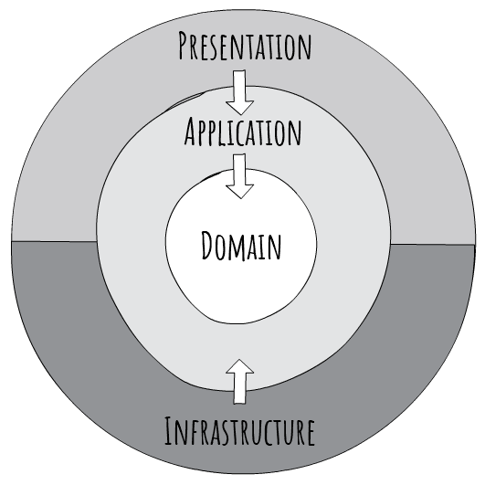
Clean Architecture

Slide 6
Problems with this
Violates SRP
Large, Bloated Controllers
Duplicate Business Rules/Validation
Poorly Modeled Domain
Invalid Domain Object States
Painful Unit Testing
Notes:
Large, Bloated Controllers: Controllers are tightly coupled together in a single class. How do we know for sure a change to one endpoint didn’t affect another?
Duplicate Business Rules/Validation: Every “service” has to validate that a duplicate task doesn’t exist. That “status” is valid, etc. These Business Rules are not encapsulated anywhere.
Poorly Modeled Domain: Again, our anemic domain is not “expressive” and gives no indication on what the intent of this system is.
Invalid Domain Object States: As soon as I knew up that object I have an invalid state and it’s up to the developer to remember everything that is needed to bring that into a valid state. Lots of room for bugs and errors
Painful Unit Testing: Unit tests should be small and test one thing. Every Unit test I have to mock out all my dependencies just to hit one thing. This results in very large and unreadable unit tests.
*** A lot of the refactoring I’m going to show aims to solve these issues.

Slide 7
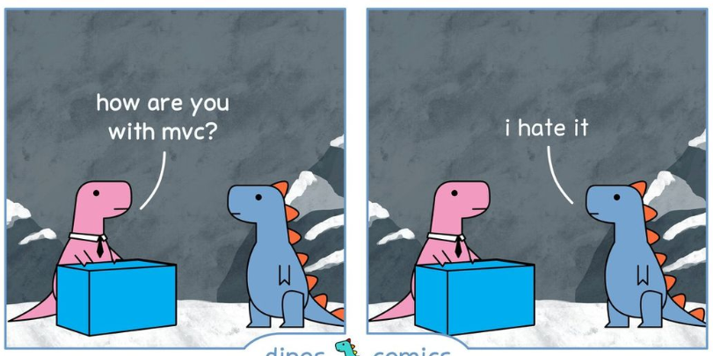
Moving Away From Controllers MVC Controllers are Dinosaurs - Embrace API Endpoints | Blog (ardalis.com)

Slide 8

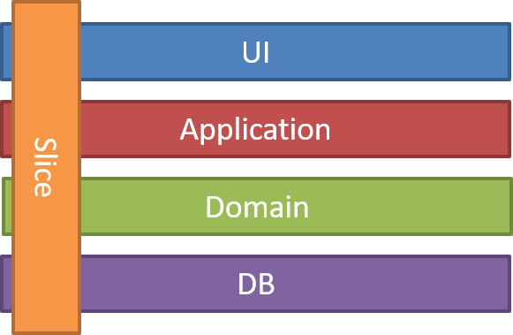

“One Endpoint One File”
Fit Nicely with Vertical Slice Architecture
REPR Pattern
(Request-Endpoint-Response)

Slide 9
Demo

Slide 10





Benefits
Models/Controllers Folders
Less Dependencies (Only What YOU Need)
Coupling Around Endpoint VS Entire Resource
Sets Us Up For CQRS
No Real Need for a Mediator
Notes:
CQRS: Really useful if we decide to do Event Sourcing and want to read from a Materialized View

Slide 11

Domain Driven Design
Notes:
DDD is a HUGE topic. What I’m focusing on are two major takeaways:
Modeling our Core Domain after the Business and encapsulating those rules within those domain entities
Using that Domain to express the intent of our system

Slide 12
Demo

Slide 13
Effective delivery techniques
This is a powerful tool in public speaking. It involves varying pitch, tone, and volume to convey emotion, emphasize points, and maintain interest.
Pitch variation
Tone inflection
Volume control
Effective body language enhances your message, making it more impactful and memorable.
Meaningful eye contact
Purposeful gestures
Maintain good posture
Control your expressions

Slide 14
Effective delivery techniques
This is a powerful tool in public speaking. It involves varying pitch, tone, and volume to convey emotion, emphasize points, and maintain interest.
Pitch variation
Tone inflection
Volume control
Effective body language enhances your message, making it more impactful and memorable.
Meaningful eye contact
Purposeful gestures
Maintain good posture
Control your expressions

Slide 15
Navigating Q&A sessions
Know your material in advance
Anticipate common questions
Rehearse your responses
Maintaining composure during the Q&A session is essential for projecting confidence and authority. Consider the following tips for staying composed:
Stay calm
Actively listen
Pause and reflect
Maintain eye contact

Slide 16

Speaking impact
Your ability to communicate effectively will leave a lasting impact on your audience
Effectively communicating involves not only delivering a message but also resonating with the experiences, values, and emotions of those listening

Slide 17
Dynamic delivery
Learn to infuse energy into your delivery to leave a lasting impression
One of the goals of effective communication is to motivate your audience
Metric | Measurement | Target | Actual
Audience attendance | # of attendees | 150 | 120
Engagement duration | Minutes | 60 | 75
Q&A interaction | # of questions | 10 | 15
Positive feedback | Percentage (%) | 90 | 95
Rate of information retention | Percentage (%) | 80 | 85

Slide 18
Final tips & takeaways
Consistent rehearsal
Strengthen your familiarity
Refine delivery style
Pacing, tone, and emphasis
Timing and transitions
Aim for seamless, professional delivery
Practice audience
Enlist colleagues to listen & provide feedback
Seek feedback
Reflect on performance
Explore new techniques
Set personal goals
Iterate and adapt

Slide 19
Speaking engagement metrics
Impact factor | Measurement | Target | Achieved
Audience interaction | Percentage (%) | 85 | 88
Knowledge retention | Percentage (%) | 75 | 80
Post-presentation surveys | Average rating | 4.2 | 4.5
Referral rate | Percentage (%) | 10 | 12
Collaboration opportunities | # of opportunities | 8 | 10

Slide 20

Thank you
Brita Tamm
502-555-0152
brita@firstupconsultants.com
www.firstupconsultants.com

